Slide 1

Medicine Recommendation System
Submitted By
Submitted To
CSE-412 213_D2
Sadia Afroze
Assistant Professor
Dept. of Computer Science and Engineering
Rabby Khan
ID: 213902037
Mostak Ahamed
ID: 213902126

Slide 2
Outline
01
Introduction
04
Objective/ Contribution
02
05
Literature Review
Methodology & Diagram
03
06
Application
Research Gap

Slide 3
Introduction
The rapid advancement of technology has revolutionized various aspects of healthcare, including the diagnosis and treatment of diseases. One such innovation is the development of medicine recommendation systems, which leverage machine learning algorithms to provide personalized recommendations for patients based on their individual characteristics and health conditions.
Machine learning
It’s an application of AI
Computers observe and analyze
Predict based on previous patterns
Pre-programmed algorithms

Slide 4
Literature Review
Traditional Methods
Machine Learning Applications
Traditional methods of medicine recommendation relied heavily on rule-based systems and expert systems, where predefined rules were used to match symptoms or patient conditions with potential treatments
Supervised Learning
Classification, Regression, Labeled Datasets
Unsupervised Learning
Clustering, Grouping Patients, Symptom Similarity
Reinforcement Learning
Decision-Making, Feedback, Optimal Treatment Plans

Slide 5
Key Research Areas
Drug Repurposing: New Uses for Existing Drugs, Hidden Correlations, Large Datasets, Potential Applications for Old Drugs.
Adverse Drug Reaction Prediction: Personalized Medicine, Risk Prediction, Patient History, Genetic Data, Environmental Factors, Preventing Side Effects.
Treatment Optimization: Personalized Dosage, Duration, Drug Combination, Patient Characteristics, Precision Medicine, Effective Treatment Strategies, Minimizing Side Effects.

Slide 6
Research Gap
Medicine recommendation systems, several limitations and challenges remain that hinder their widespread adoption and effectiveness:
Limitations of Existing Systems
Limited Personalization: Predefined rules/static models; do not account for individual variability (genetics, lifestyle, history); generalized treatments.
Data Quality and Availability: Incomplete or biased datasets; lack of up-to-date medical data; inaccurate recommendations.
Scalability Issues: Inefficient handling of large datasets; difficulty in scaling to larger populations; lack of real-time adaptability.
Inability to Predict Long-Term Outcomes: Focus on immediate symptoms; neglects cumulative effects of treatments over time.

Slide 7
Research Gap
Medicine recommendation systems, several limitations and challenges remain that hinder their widespread adoption and effectiveness:
Need for Advanced Algorithms
Improved Accuracy and Personalization:
Integration of Multimodal Data:
Incorporating Real-Time Data and Patient Preferences
Real-Time Data Incorporation
Patient Preferences and Engagement:

Slide 8
Objective/Contribution
Primary Objective
Develop an intelligent medicine recommendation system that provides personalized and accurate recommendations based on individual health data.
Leverage machine learning techniques to enhance decision-making for healthcare providers by integrating symptoms, medical history, and lifestyle factors.

Slide 9
Objective/Contribution
Specific Contributions
Development of Novel Algorithms
Improved Prediction Accuracy
Addressing Identified Limitations
Enhanced Personalization
Data-Driven Decision Making
Efficiency and Scalability

Slide 10
Methodology Diagram
Our Medicine Recommend System is implemented using the three data mining algorithms i.e., Decision Tree classifier, Random Forest classifier and Naive Bayes classifier.
Data Collection:
Gathered dataset with medical symptoms and corresponding diseases.
Preprocessing:
Handled missing or incomplete data.
Normalized data for consistent input to classifiers.

Slide 11
Methodology Diagram
Our Medicine Recommend System is implemented using the three data mining algorithms i.e., Decision Tree classifier, Random Forest classifier and Naive Bayes classifier.
3. Training the Models:
1.Decision Tree Classifier:
Built tree-based model for classification.
2. Random Forest Classifier:
Utilized ensemble method of multiple decision trees.
3. Naive Bayes Classifier:
Applied probabilistic approach for disease classification.
4. Prediction:
Trained models to predict diseases based on symptoms.

Slide 12
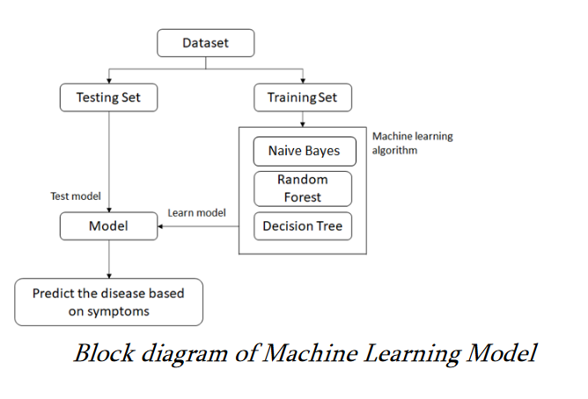
Methodology Diagram
The proposed medicine recommendation system architecture can be broken down into several key components, each playing a vital role in the overall functionality of the system.

Slide 13
Applications of the Medicine Recommendation System
Application
The Medicine Recommendation System can be utilized in various settings, including:
Telemedicine Platforms: To assist patients in receiving quick medication suggestions without needing an in-person consultation.
Pharmacies: Enabling pharmacists to recommend appropriate medications in the absence of a doctor.
Healthcare Providers: Supporting doctors in making informed decisions based on symptom analysis and historical data.
General Public: Allowing individuals to self-assess minor health issues and receive guidance on potential medications.

Slide 14
Conclusion
"In conclusion, our Medicine Recommendation System aims to revolutionize the way patients receive treatment by providing personalized, data-driven recommendations. Through the use of machine learning algorithms, we hope to address the gaps in current systems and improve healthcare outcomes for all."

Slide 15
References
Here are the references we used to support our research.
https://ieeexplore.ieee.org/abstract/document/10099607/
https://www.academia.edu/download/64499739/IRJET-V7I3310.pdf
https://www.academia.edu/download/66684115/IJARET_12_03_062.pdf

